Slide 1

Chapter 3
Researching Culture
Notes:
For a better classroom presentation flow, the order of some topics in this lecture outline differs slightly from the order of topics in the text and, where this occurs, some figures and tables are out of numerical order.

Slide 2
Learning Objectives
  3.1 Discuss how cultural anthropologists do research.
  3.2 Recognize what fieldwork in cultural anthropology involves.
  3.3 List some urgent issues in cultural anthropology research.

Slide 3
Changing Research Methods
3.1 Discuss how cultural anthropologists do research.
From the Armchair to the Field
Participant Observation

Slide 4
From the Armchair to the Field
History of Fieldwork
  1870s: “Armchair” approach
  Early 1900s: “Verandah” approach
  Today: Participant observation

Slide 5
Participant Observation (1 of 5)
Participant observation:
  Learning about culture by living in a culture for an extended period
  Bronislaw Malinowski took this approach while studying the people of the Trobriand Islands
  Key elements:
    Living with the people
    Participating in their everyday life
    Learning the language

Slide 6
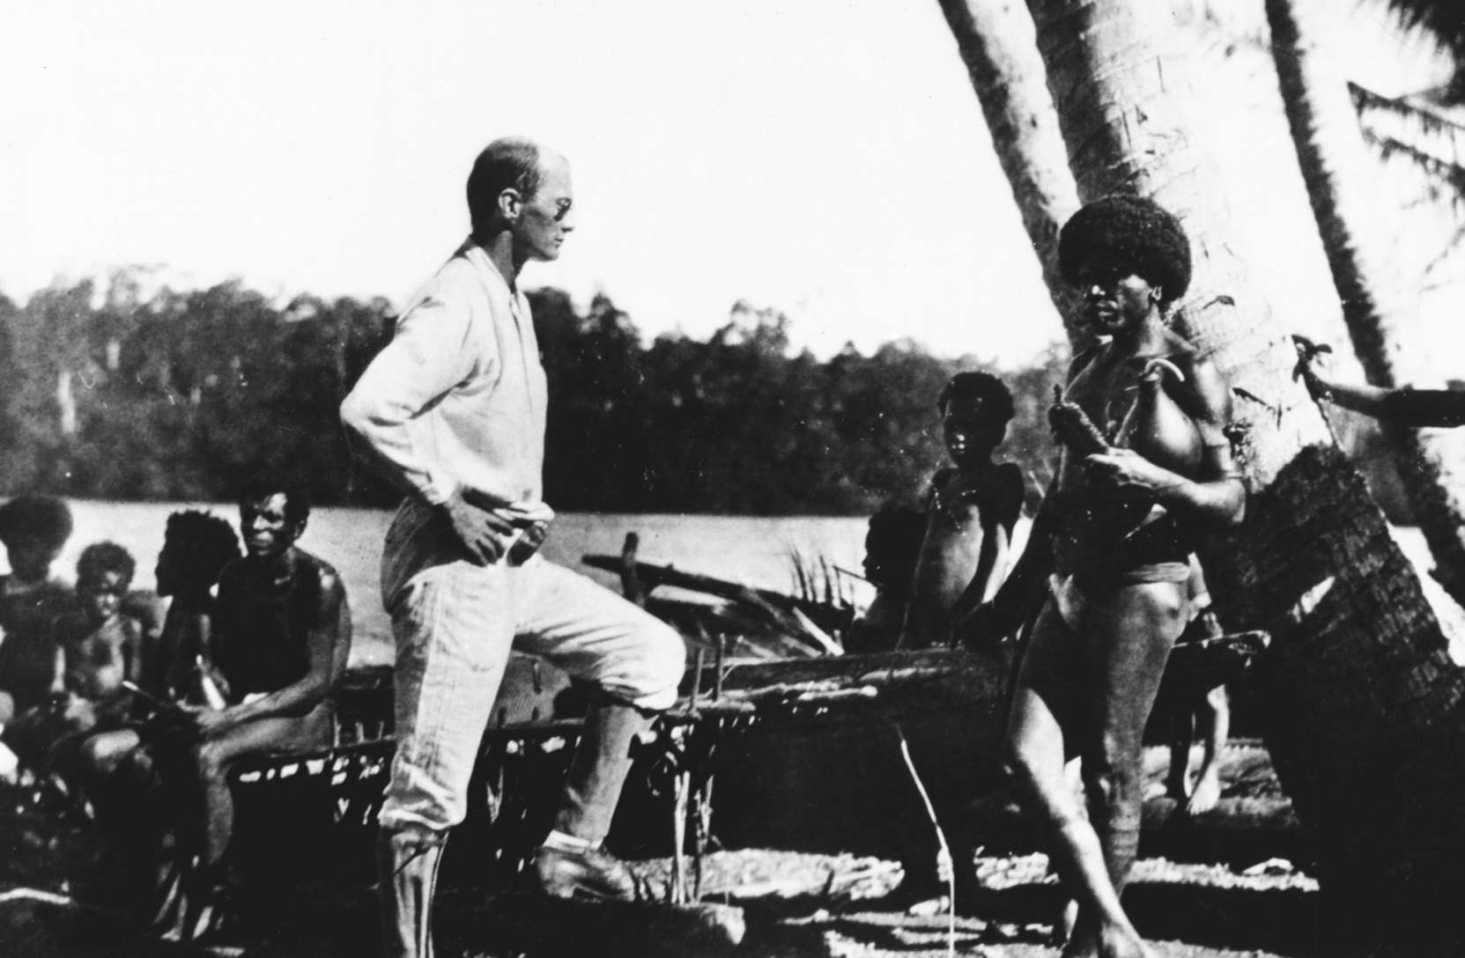
Participant Observation (2 of 5)
Notes:
Bronislaw Malinowski during his fieldwork in the Trobriand Islands, 1915–1918.

Slide 7
Participant Observation (3 of 5)
Early fieldwork and participant observation:
  Goal: to record as much as possible of a people’s language, songs, rituals, and social life because many cultures were disappearing
  Most research was conducted in small, isolated cultures

Slide 8
Participant Observation (4 of 5)
Changing methods in a global world:
  Few, if any, isolated cultures remain
  Anthropologists need methods for studying
    Larger-scale cultures
    Global–local connections
    Cultural change

Slide 9
Participant Observation (5 of 5)
Innovation: Multisited Research
  Fieldwork conducted on a topic in more than one location
  Especially helpful for studying migrant populations
  Example: Lanita Jacobs-Huey’s research about the language and culture of hairstyles among African American women

Slide 10
Culturama: The Trobriand Islanders of Papua New Guinea
Coral atolls east of the island of New Guinea
Colonized by Great Britain and ceded to Australia in 1904; became part of Papua New Guinea in 1975
Christian missionaries introduced cricket as substitute for warfare
Language: many different dialects but all speak a version of Kilivila
Grow much of their own food: root crops, bananas, breadfruit, coconuts, and betel nuts
Pigs raised for food and as prestige item
Kinship emphasizes the female line
Contemporary challenges include the money economy and overfishing

Slide 11
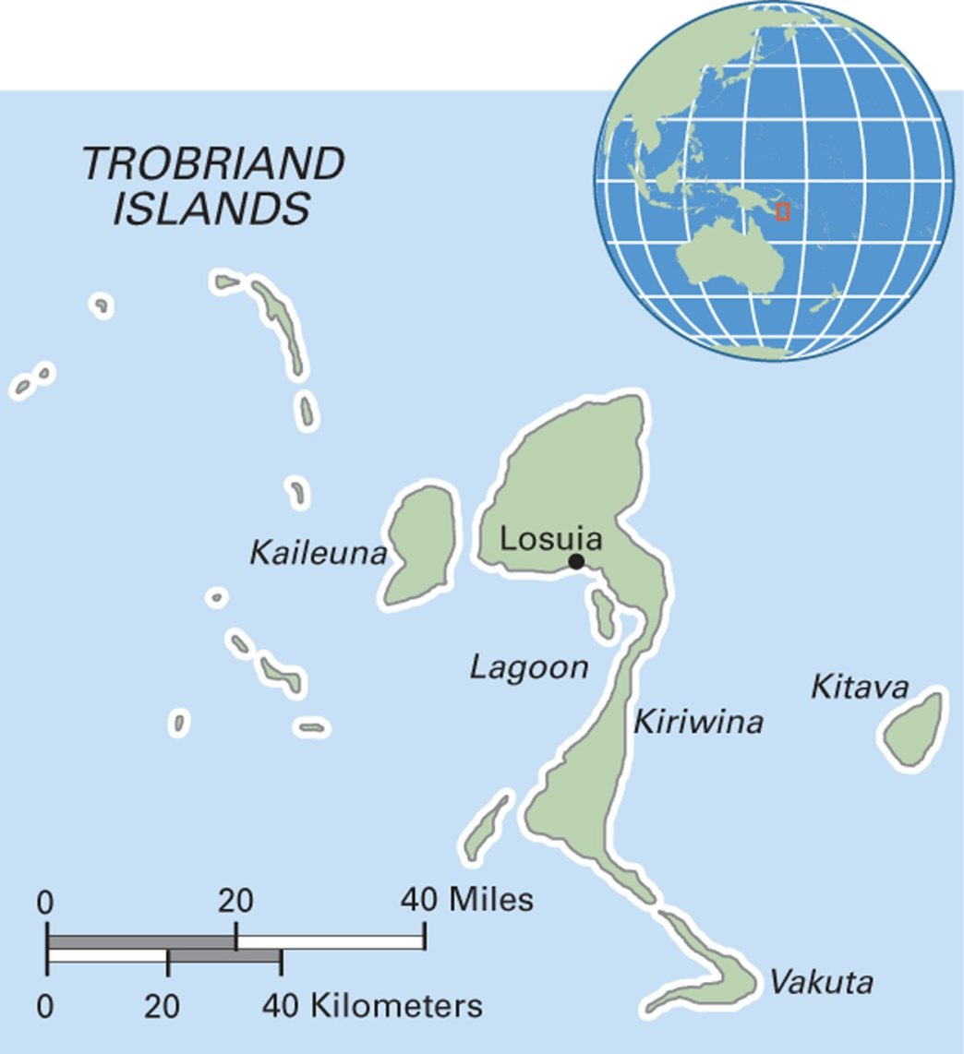
Map 3.1 Trobriand Islands of Papua New Guinea
Notes:
Also known as the Kiriwina Islands, the Trobriands are an archipelago of coral atolls lying off the eastern coast of the island of New Guinea.

Slide 12
Anthropology Works:
What’s for Breakfast in California
Anthropological research applied to product development:
  Anthropologists did focused research in homes of employed Californians
  Breakfast was a rushed affair, but parents wanted kids to have a good meal
  Result: Go-Gurt

Slide 13
Doing Fieldwork in Cultural Anthropology
3.2 Recognize what fieldwork in cultural anthropology involves.
Beginning the Fieldwork Process
Working in the Field
Fieldwork Techniques
Recording Culture

Slide 14
Beginning the Fieldwork Process (1 of 2)
Choosing a research topic:
  Find gaps in literature
  Current events
  Focus on a commodity
  Restudy
    Example of the Trobriand Islanders
  Luck!

Slide 15
Beginning the Fieldwork Process (2 of 2)
Preparing for the field:
  Funding
  Visas and permission to conduct research
  Ethical considerations
    AAA Code of Ethics
    Protection of “human subjects” and Institutional Review Boards (IRBs)
    Informed consent
  Specialized equipment, medical kit
  Language training
  Personal safety considerations

Slide 16
Working in the Field (1 of 7)
Site selection
Gaining rapport
Gift-giving and exchange
  Gifts should be culturally and ethically appropriate
Microcultures and fieldwork
Issues of race, class, gender, and age
Culture shock

Slide 17
Working in the Field (2 of 7)
Site Selection Factors:
  The size of the population(s)/area(s) depends on the topic being researched
  Topic may require a specialized location, such as a clinic
  Many communities do not welcome researchers
  Often, housing shortages mean the community cannot make space for the anthropologist
  Example: Jennifer Robertson in Kodaira, Japan

Slide 18
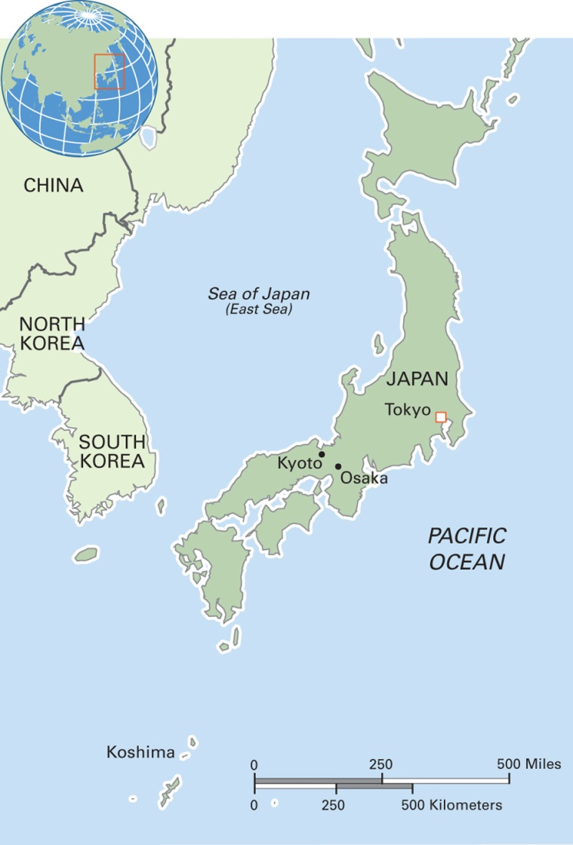
Map 3.2 Japan
Notes:
The State of Japan encompasses 6,852 islands, most of which are mountainous. Its population is over 127 million with over 80 percent living on Honshu. Greater Tokyo, with 34 million residents, is the largest metropolitan area in the world. After the United States and China, Japan has the world’s third-largest economy.

Slide 19
Working in the Field (3 of 7)
Gaining Rapport:
  Rapport is a trusting relationship between the researcher and the study population
  Important to establish rapport with gatekeepers
  Anthropologists are often labeled as spies
    Example: Christa Salamandra in Damascus, Syria

Slide 20
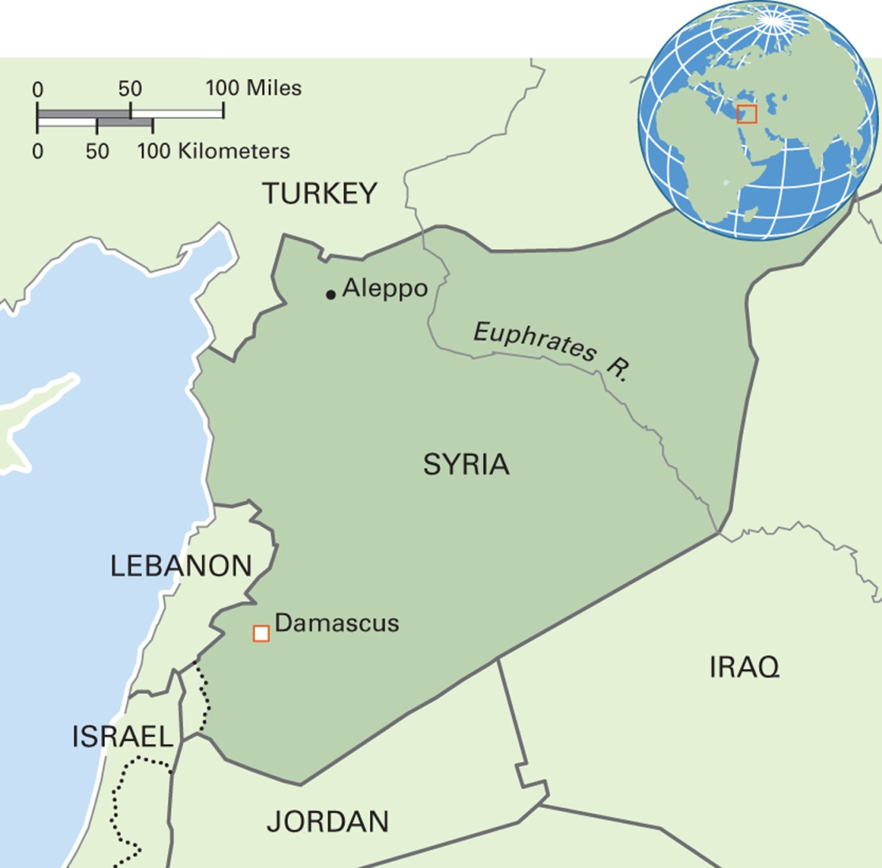
Map 3.3 Syria
Notes:
The Syrian Arabic Republic historically included the present-day territories of Lebanon, Israel, the Palestinian Territories, and parts of Jordan. The population of Syria is 18 million people. The capital city, Damascus, with a population of 2.5 million people, is one of the oldest continually inhabited cities in the world. Since the onset of the civil war in 2011, over nine million Syrians have been displaced internally, and over four million are refugees living outside Syria in dire conditions.

Slide 21
Working in the Field (4 of 7)
Gift-Giving and Exchange
  Giving gifts can help the project proceed
  Gifts should be culturally and ethically appropriate
  Important to learn the local rules of exchange

Slide 22
Working in the Field (5 of 7)
Other considerations in gift-giving (Figure 3.2 Culture and Gift-Giving in the Field)
  What is an appropriate gift
  How to deliver a gift
  How to behave as a gift-giver
  How to behave when receiving a gift
  Whether and how to give a follow-up gift

Slide 23
Working in the Field (6 of 7)
Microcultures and Fieldwork
  Class, race, gender, age, and other microcultural factors may affect how local people will perceive and welcome an anthropologist

Slide 24
Working in the Field (7 of 7)
Culture Shock:
  Feelings of
    Uneasiness, loneliness, and anxiety that occur when a person shifts from one culture to another
    Reduced competence as a cultural actor
  Can include problems with food, language barriers, and loneliness
  Reverse culture shock may occur after coming home

Slide 25
Fieldwork Techniques (1 of 6)
Research and Data
Recording Culture
Data Analysis

Slide 26
Fieldwork Techniques (2 of 6)
Two Research Approaches:
  Etic: Data collected according to the researchers’ questions and categories; “deductive”; goal of being able to test a hypothesis; preferred by cultural materialists
  Emic: Seeks to understand what insiders say and understand about their culture, their categories of thinking; “inductive”; not hypothesis-driven; preferred by interpretivists

Slide 27
Fieldwork Techniques (3 of 6)
Figure 3.3 Methods in Cultural Anthropology
The inductive (emic) approach uses qualitative data from sources like participant observation, interviews, video, archival data, life history
The deductive (etic) approach uses quantitative data from sources like participant observation, interviews, surveys, time allocation, census data, or other statistics
The mixed approach uses qualitative and quantitative data from whichever of the above sources are relevant to the study objectives

Slide 28
Fieldwork Techniques (4 of 6)
Data-collection techniques and specialized methods include:
  Interviews
  Questionnaires
  Watching and asking
  Life history
  Time allocation study
  Text/historical sources
  Team projects

Slide 29
Fieldwork Techniques (5 of 6)
Recording culture:
  Field notes—logs, personal journals, descriptions of events, and notes about those notes
  Tape recording, photography, and videos
    Example: audio recording in Spain
    Example: photography in Iceland

Slide 30
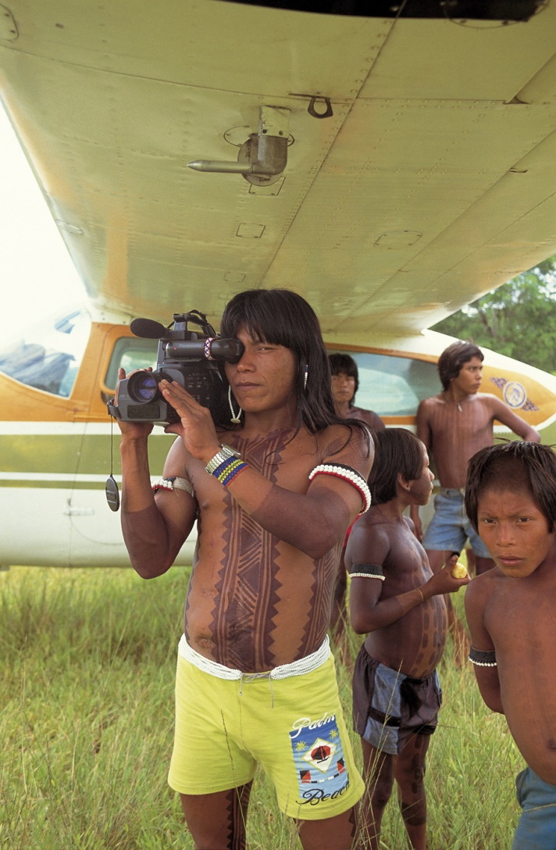
Fieldwork Techniques (6 of 6)
Notes:
In the Xingu (zeen-goo) region of the Brazilian Amazon, a Kayapo Indian uses a video camera to document public events. Since the 1980s, and largely as the result of cultural anthropologist Terry Turner’s work with the Kaiapo, they have used video to record ceremonies and other traditional events as well as their political encounters with Brazilians who have been pushing, for decades, to build a large dam that will affect thousands of acres of Indian lands.

Slide 31
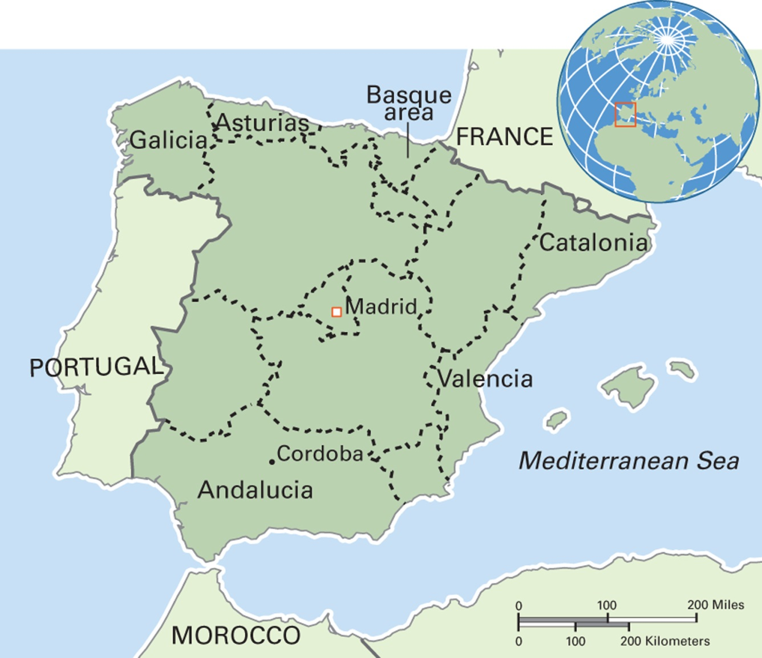
Map 3.5 Spain
Notes:
The Kingdom of Spain is the largest of the three countries occupying the Iberian Peninsula (Spain, Portugal, and Andorra). The geography is dominated by high plateaus and mountain ranges. Spain’s population exceeds 47 million of which more than five million are foreign residents. Within the European Union, Spain has the highest immigration rate after Cyprus. Spain’s administrative structure is complex, including autonomous communities, such as Andalucía and Catalonia, and provinces. The central government is granting more autonomy to some localities, including the Basque area.

Slide 32
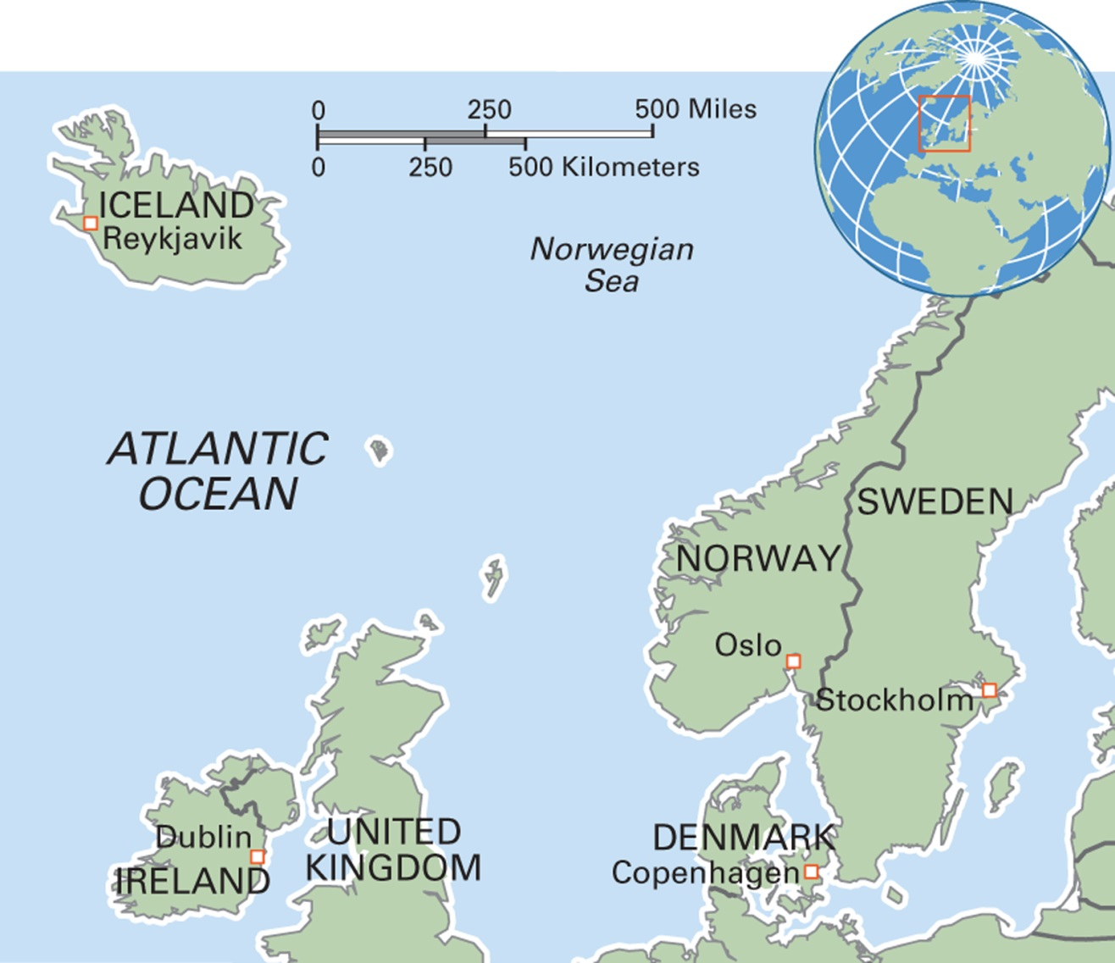
Map 3.6 Iceland
Notes:
The Republic of Iceland has a population of 320,000. A volcanic island, its economy is based on exporting fish products, technology, and tourism. Its Gross Domestic Product (GDP) has suffered since the economic crisis of 2007—2008, and many people have outmigrated. Icelandic Sign Language was officially recognized as a national language in 2011.

Slide 33
Eye on the Environment: Inuit Place Names and Landscape Knowledge (1 of 2)
South Baffin Island Place Name Project
  Dedicated to collecting and recording Inuit place names and landscape knowledge
  As most Inuit are now settled in villages and towns, this knowledge is in danger of being lost
  Looks at toponymy and indigenous knowledge

Slide 34
Eye on the Environment: Inuit Place Names and Landscape Knowledge (2 of 2)
Collecting data
  Community-wide workshops
  One-on-one interviews
  Participant observation
  Analysis and archiving

Slide 35
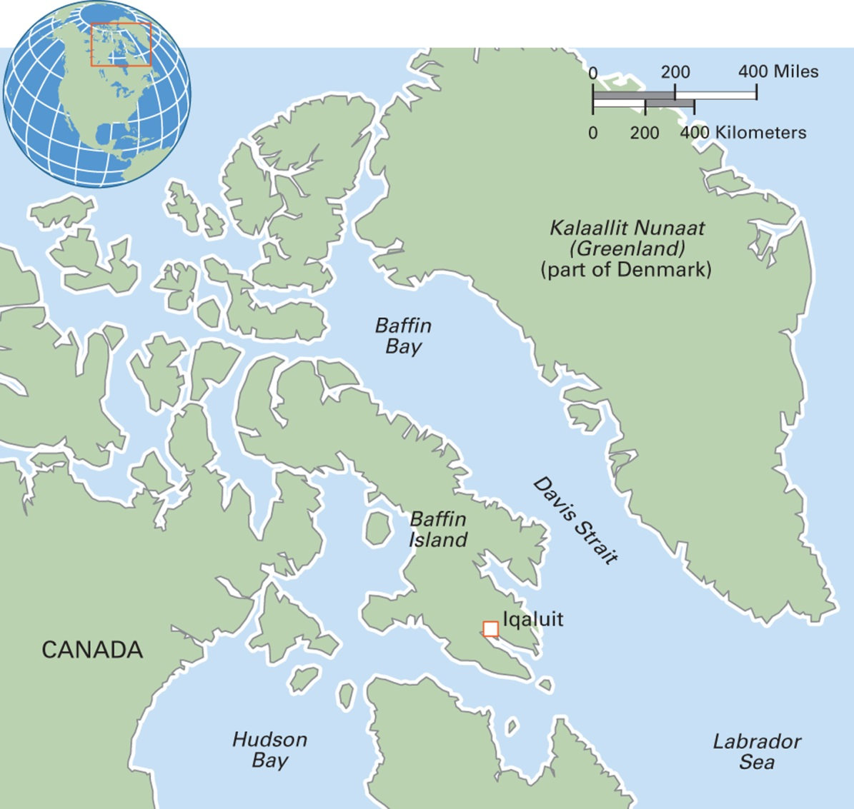
Map 3.4 Baffin Island in Northeast Canada
Notes:
Baffin Island, the largest island in the Canadian Arctic, has a population of 11,000. The Inuit name for the island is Qikiqtaaluk. It is part of the territory of Nunavut and Iqaluit, a town of about 3,000 people, is the capital.

Slide 36
Data Analysis (1 of 2)
Qualitative Data
  Prose-based description
    Varies widely in form depending on the type of data and the approach of the anthropologist
Quantitative Data
  Numeric presentation
    Statistics

Slide 37
Data Analysis (2 of 2)
Ethnography—descriptive writing about a culture
  The main way cultural anthropologists present their findings
  Early ethnographers wrote about “exotic” cultures located far from Europe and North America
  Ethnographies have changed in recent decades

Slide 38
Urgent Issues in Cultural Anthropology Research
3.3 List some urgent issues in cultural anthropology research.
Ethics and Collaborative Research
Safety in the Field

Slide 39
Ethics and Collaborative Research (1 of 3)
Ethics in Anthropology
  Issue of ethics was prompted by Project Camelot and the Vietnam War
  In 1971 the American Anthropological Association adopted a code of ethics
  Does not condone “undercover” research
  The anthropologist’s main responsibility is to ensure the safety of the people participating in the research

Slide 40
Ethics and Collaborative Research (2 of 3)
New Approach: Collaborative Research
  Members of the study population work as partners with the anthropologist in
    Data collection
    Data analysis
    Presentation of findings
    Sharing credit for results

Slide 41
Safety in the Field
Physical and psychological risks
Violence
War zone anthropology
  Provides important insights into militarization, protection, post-conflict reconstruction
  Requires special training and experience

